Slide 1
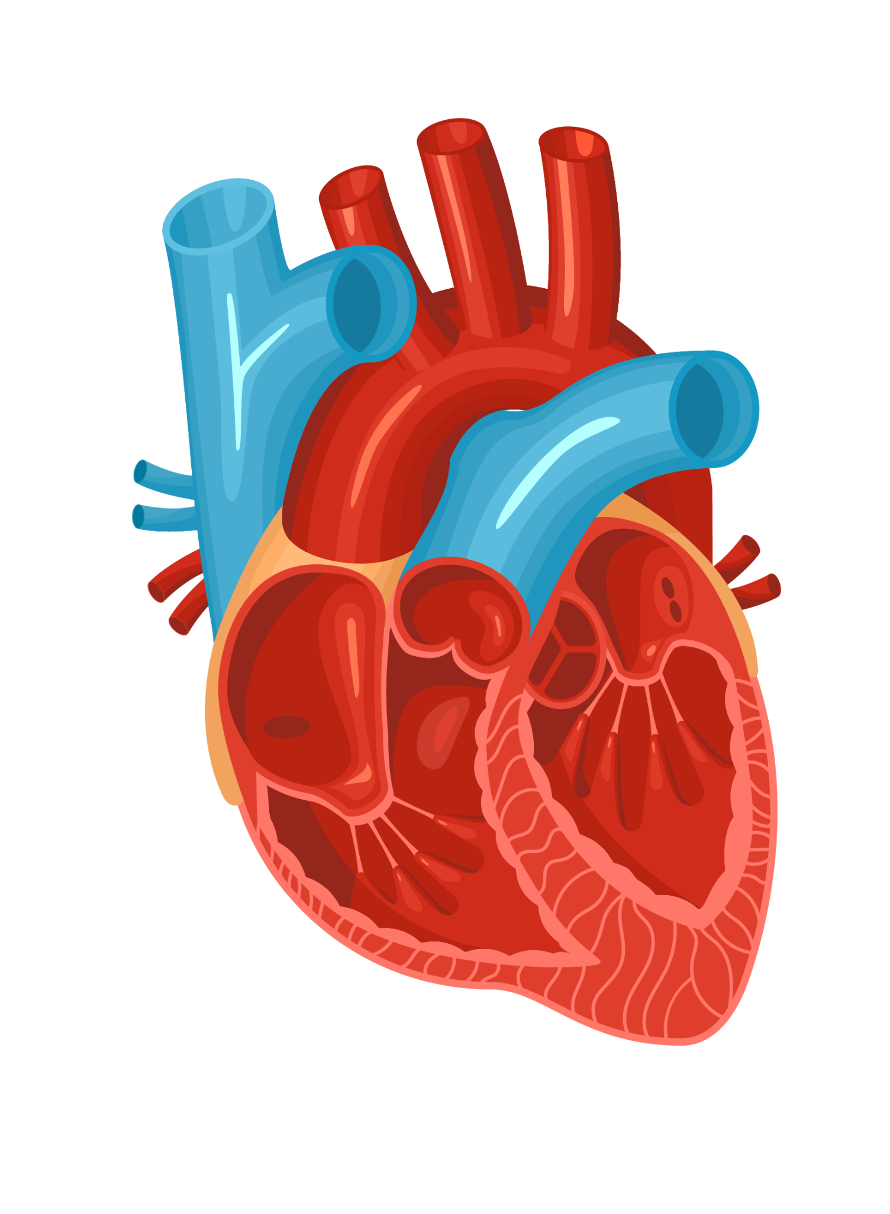
Pulse Sync
Aanya Patel & Raajdeep Kaur

Slide 2
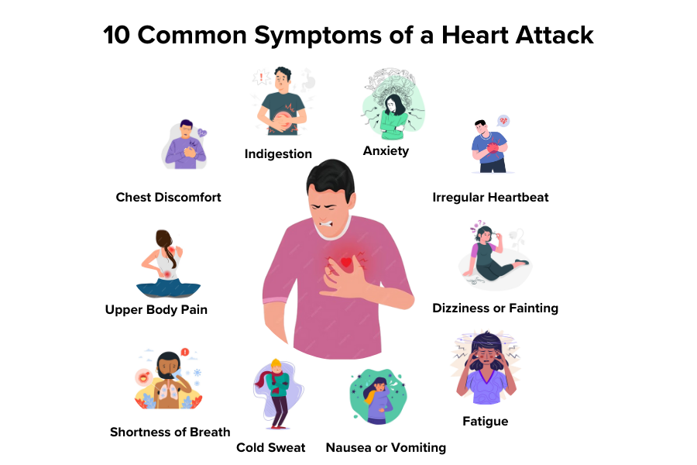
The Problem
Notes:
Sure everyone has faced some level of stress before
Elevated heart rates, being overwhelmed by just everyday life
Not to scare anyone, but anxiety and stress is one of the major reasons for heart related issues
It can lead to unhealthy habits - overeating or undereating ; consuming excessive amounts of alcohol
It can also lead to temporary spikes in blood pressure
It can increase inflammation in the body - specifically in blood vessels
This is where Pulse Sync can help.
Heart rate sensor at the bottom
And a display at the top which shows the BPM detected by the heart rate sensor
If the BPM is in a good range, its green (good), If not, it turns red.
Moreover, if it’s unhealthy, it showcases some immediate remedies to solve the same, that can help with temporary spikes in heart rates. If it is for a longer period of time, they will be directed to contact emergency
Future Plans →
Connect it to a website or app - to input age and weight information (to make it more specific to the user)
Connect it to your emergency contacts to send a message incase something happens
Vibration motor: alarm you if you are not paying attention (for consistent unhealthy BPM)

Slide 3
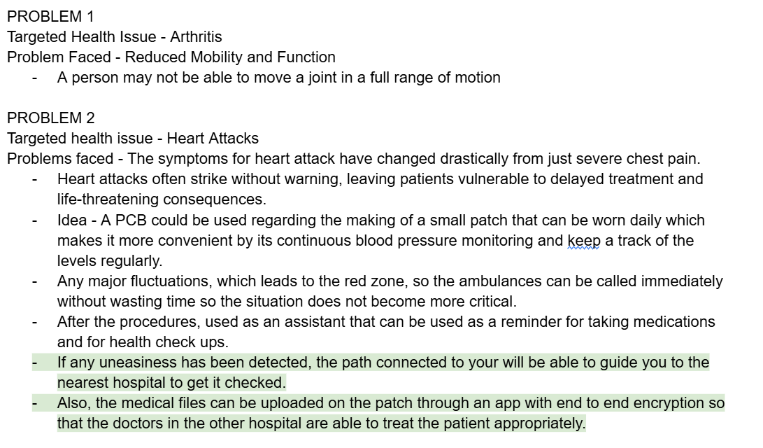
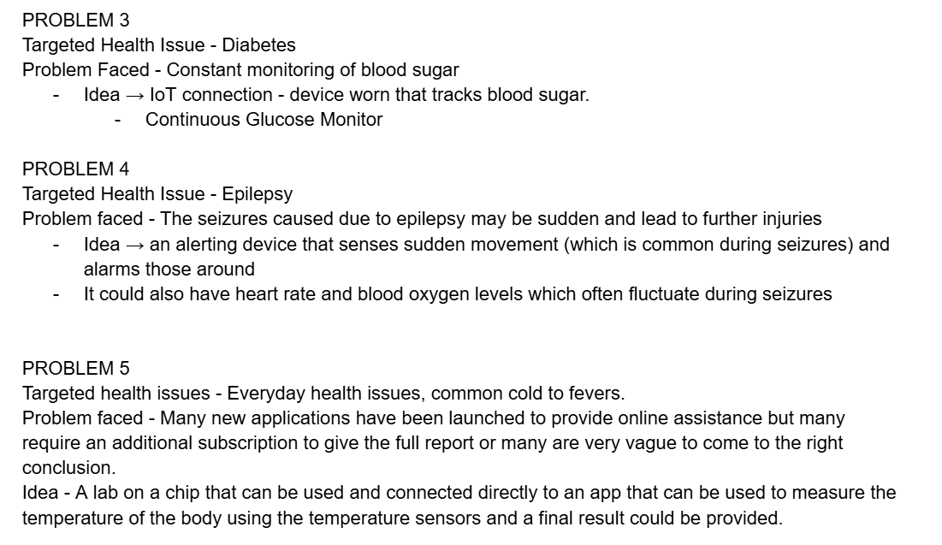
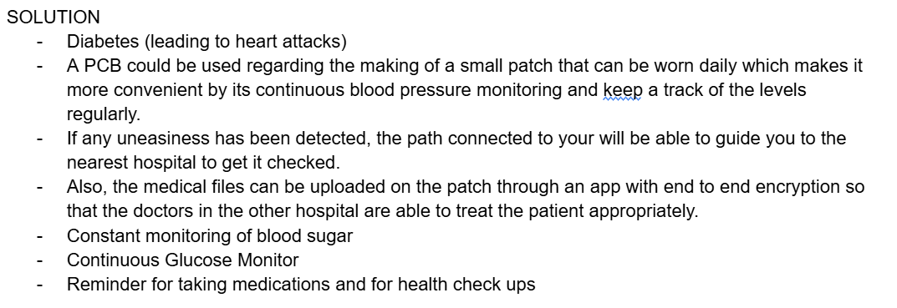
Ideating
Notes:
We began by exploring various health problems and their possible solutions.
• After careful review, we found that many of these issues lead to heart attacks.
• We wanted to focus on prevention, especially by monitoring common early symptoms like anxiety and stress.
• Our initial idea was to build an anxiety sensor patch, but as we worked on the design, we realized a wearable band would be more practical, user-friendly, and suitable for continuous monitoring.

Slide 4
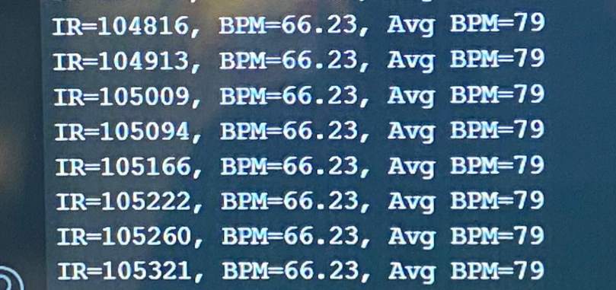
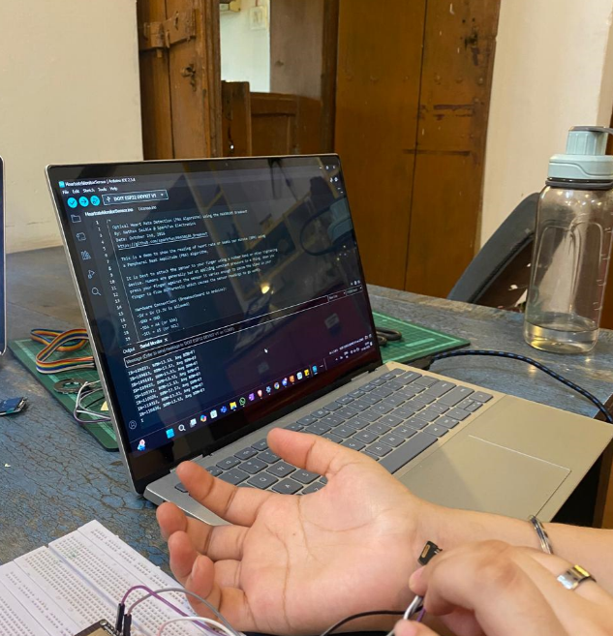
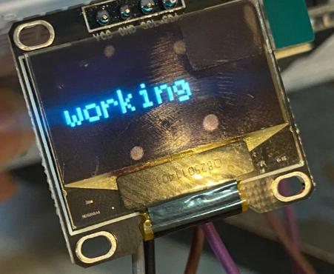
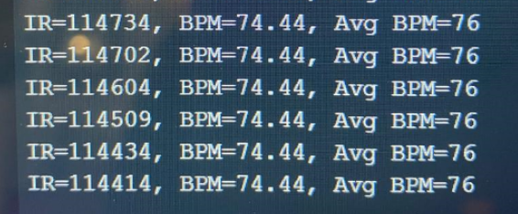
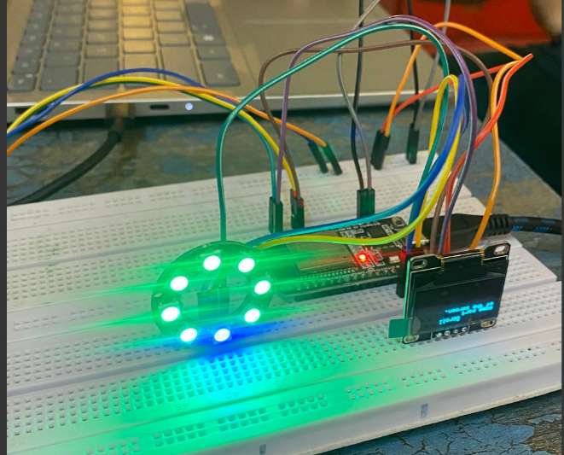
First Working Prototype
Notes:
• On the first day, we faced a delay as not all sensors were delivered.
• Just as we were about to finish, a new, smaller microcontroller (Xiao ESP32C3) arrived.
• This required us to rewrite most of the code and troubleshoot new compatibility issues.
• It was a major setback, but eventually, we adapted all the sensors to the new system.

Slide 5
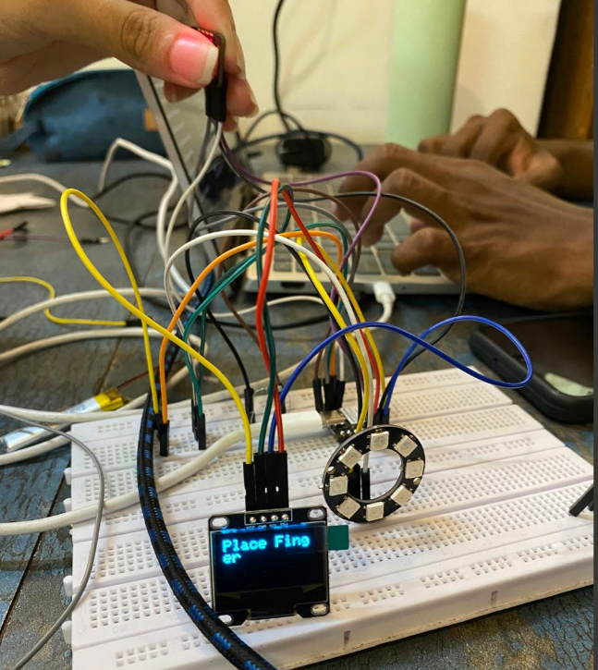
Second Working Prototype
Why did we change from arduino to Xiao?
Primarily, for making it in smaller size and less power is consumed, which makes it the best for our wearable.
Notes:
• We worked through 4 different prototype designs to keep the wearable as compact as possible.
• We faced wiring challenges, especially with the OLED and LED ring connections, which required us to change the hidden wires twice to get stable performance.
• After weighing our options, we decided to use a perfboard instead of soldering each wire because it made the device neater and easier to repair in the future.
• Beyond just warning users about their heart rate, we added real-time remedies and emergency contact suggestions based on the BPM readings.
• These health suggestions were carefully researched to ensure they are medically helpful until professional help arrives.

Slide 6
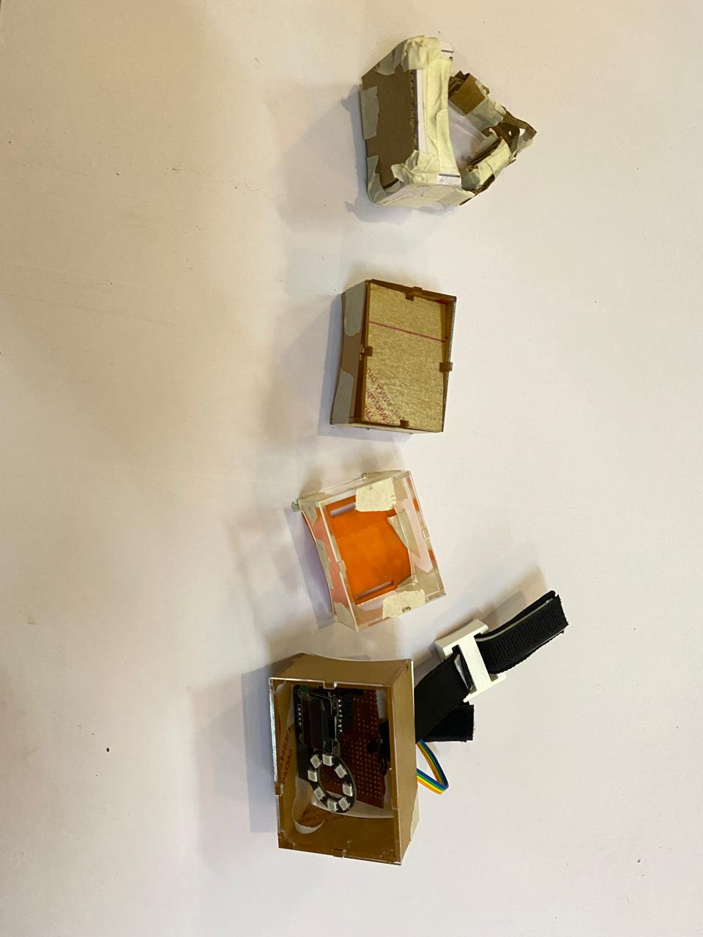
The Designing Process

